Slide 1
2024 ELECTION RESULT ANALYSIS
Task3: Mentorness data analyst intern

Slide 2
objective
The objective of this task is to analyze the 2024 election data to gain insights into the election results, party performance, and voter trends across various constituencies. I have used Power BI to create interactive visualizations and dashboards that will help stakeholders understand the election outcomes and the dynamics between different political alliances.

Slide 3
Data description
Election Results Data:
_id: Unique identifier for each record, State: Name of the state, Const. No.: Constituency number, Constituency: Name of the constituency, Leading Candidate: Name of the leading candidate, Leading Party: Name of the leading party, Trailing Candidate: Name of the trailing candidate, Trailing Party: Name of the trailing party, Margin: Vote margin between the leading and trailing candidates, Status: Status of the election result (e.g., Won, Lost, Leading, Trailing).
Party Alliance Data: -
Party Name: Name of the political party, Alliance Name: Name of the political alliance the party belongs to.

Slide 4
Insights
Average Vote Margin turned out to be 162.35K.
Leading Party with most number of seats is Bharatiya Janta Party.
INDIA was the Trailing Alliance for 242 seats.
Out of the 80 seats in Uttar Pradesh more than 50% were led by INDIA alliance.
NDA led 100% seats in Madhya Pradesh and won 24 out of 25 seats in Gujrat.

Slide 5
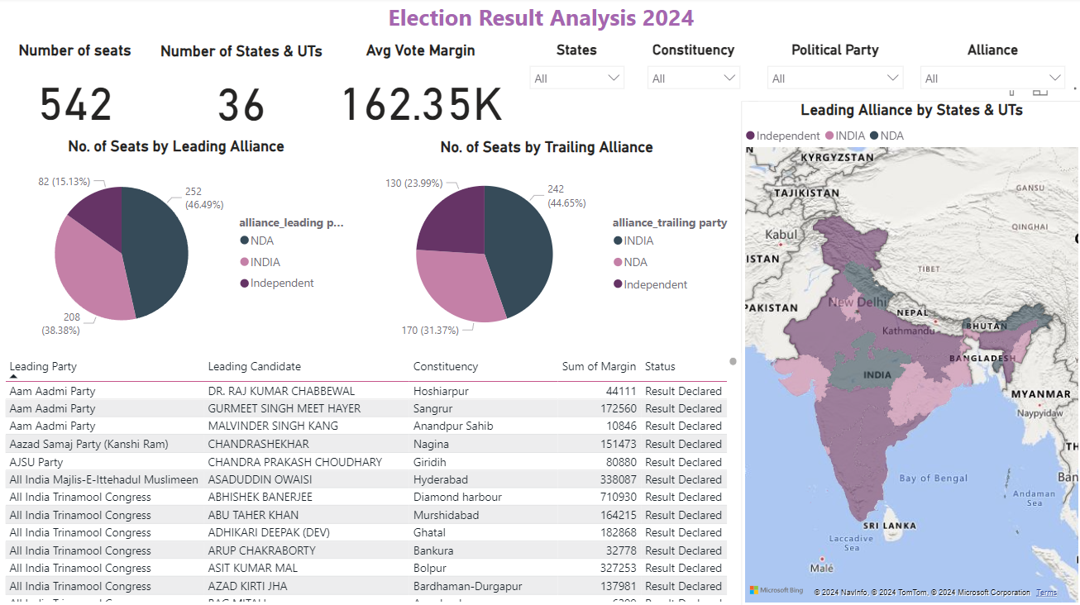
Visualizations

Slide 6
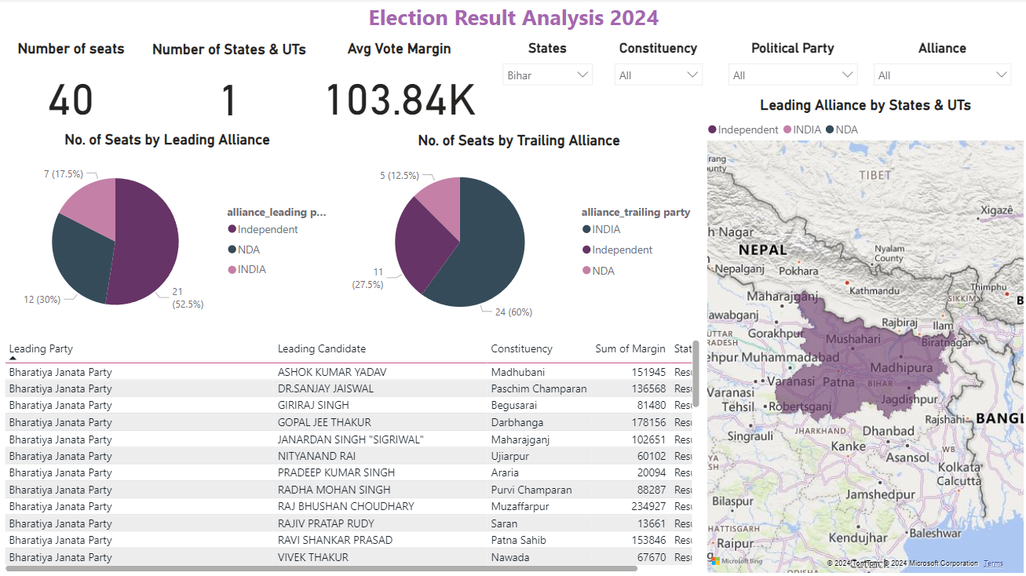
Filter by State

Slide 7
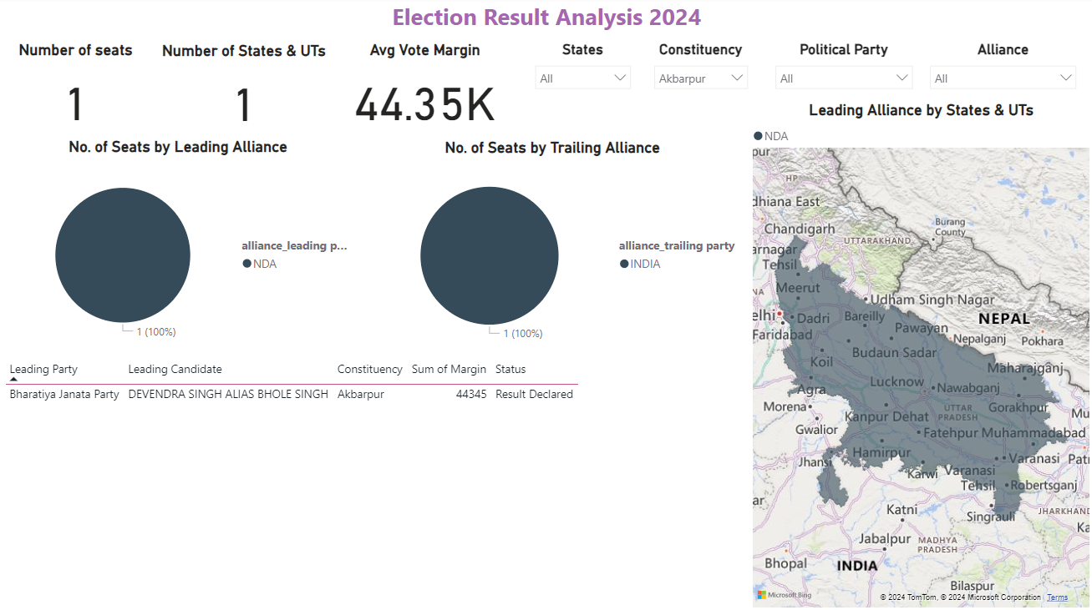
Filter by constituency

Slide 8
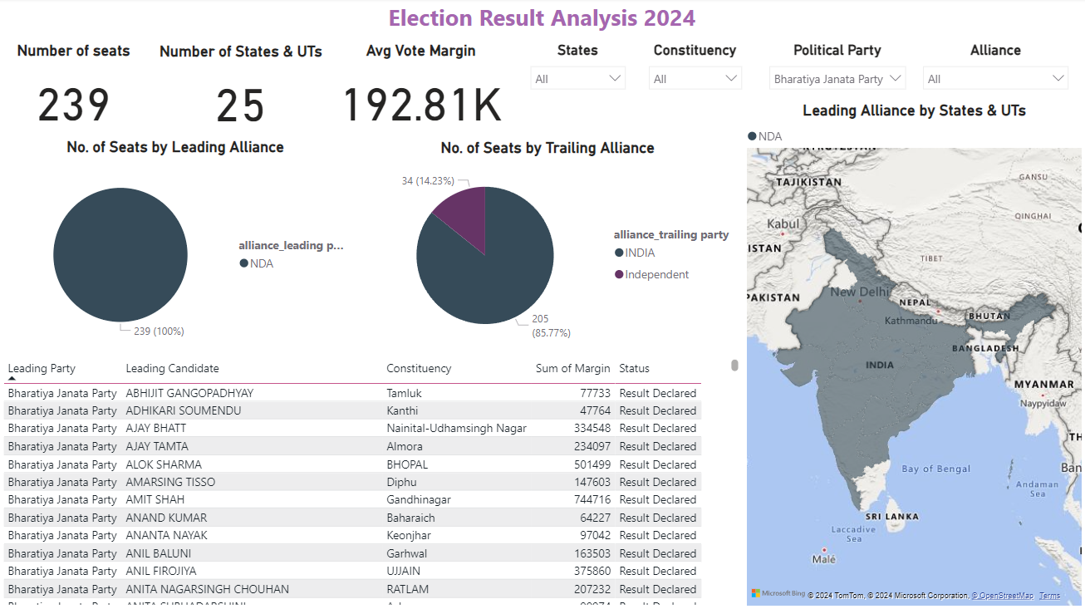
FILTER BY POLITICAL PARTY

Slide 9
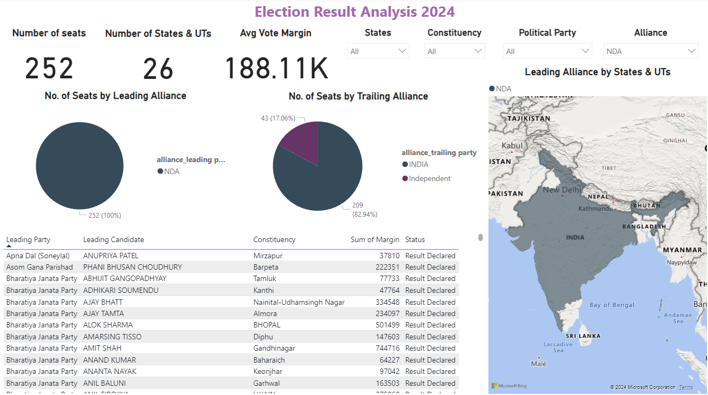
Filter by political alliance

Slide 10
recommendations
With correct campaigning and by raising more relevant issues the INDIA Alliance may be able to surpass NDA in the next election.
NDA Alliance, needs to work on their agenda better in the states like Kerala, Tamil Nadu, Punjab and Uttar Pradesh to get ahead of the opposition alliance.

Slide 11
THANK YOU!

